Slide 1
M1

Slide 3

14. NATURAL RESOURCES
Earth is the only planet on which life exists
It is due to factors like
Temperature
Water
Food
Energy from the sun
are the basic requirements of life
Resources on the earth

Slide 4
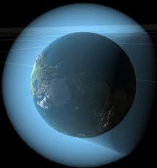
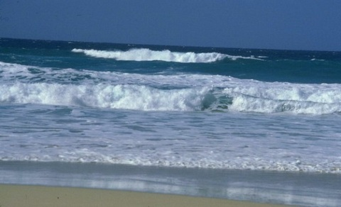
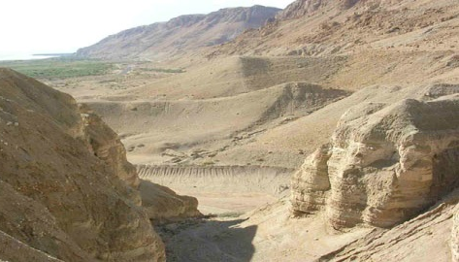
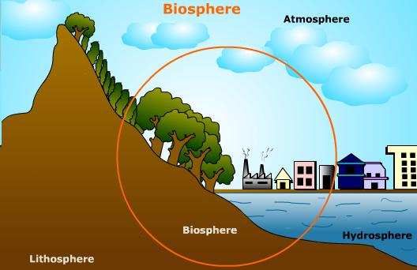
Resources on the earth are
Land, Water and Air
Outer crust of the earth
Water covers 75% of the earth’s surface
Air that covers the earth
Life supporting zone on the earth where the atmosphere, the hydrosphere and the lithosphere interact and make life possible
is called
Lithosphere
Hydrosphere
Atmosphere
Biosphere
is called
is called
is called

Slide 5
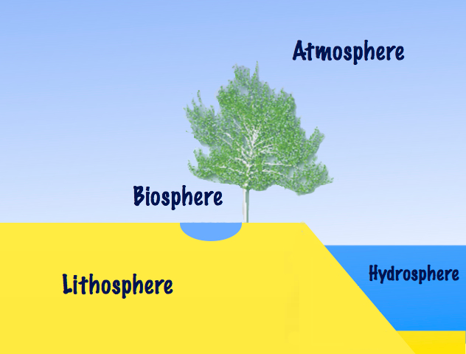
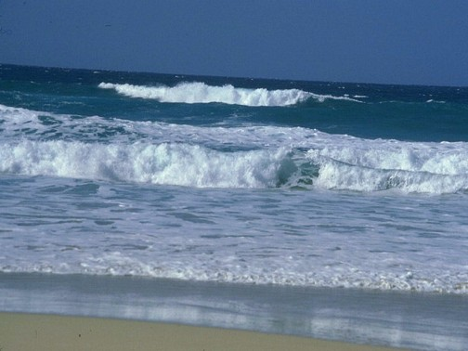

BIOSPHERE
is made up of two components
Living
Non-living
BIOTIC
ABIOTIC
Plants, animals, microorganisms.
Air, soil, water.

